Slide 1


CALCULATING FAMILY EXPENSES USING SERVICE NOW
Team Id: NM2025TMID13476
Team Members:4
Team Leader: JOTHI PRIYAN P
Team Member 1: MADHU GOKUL V.P
Team Member 2: SANJAY M
Team Member 3: JESTIN E
Problem Statement:
Objective: To design and implement a ServiceNow-based solution that automates the tracking, calculation, and reporting of family expenses. The project aims to centralize expense data, categorize spending (e.g., food, utilities, education, healthcare, leisure), and provide real-time visibility into financial patterns. By leveraging ServiceNow’s workflow automation, reporting, and integration capabilities, the solution will enable efficient budget management, reduce manual effort, and support informed financial decision-making for families.
TASK INITIATION
Setting up ServiceNow Instance
Sign up for a developer account on the ServiceNow Developer site “https://developer.servicenow.com”.
Once logged in, navigate to the "Personal Developer Instance" section.
Click on "Request Instance" to create a new ServiceNow instance.
Fill out the required information and submit the request.
You'll receive an email with the instance details once it's ready.
Log in to your ServiceNow instance using the provided credentials.
Now you will navigate to the ServiceNow.

Slide 2
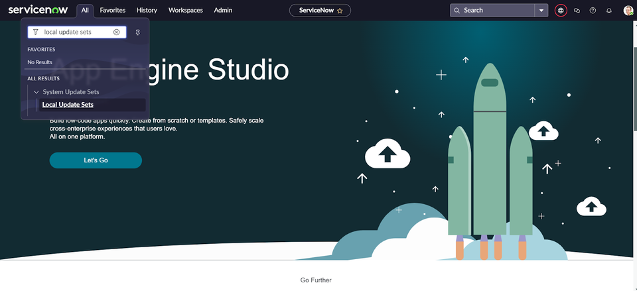
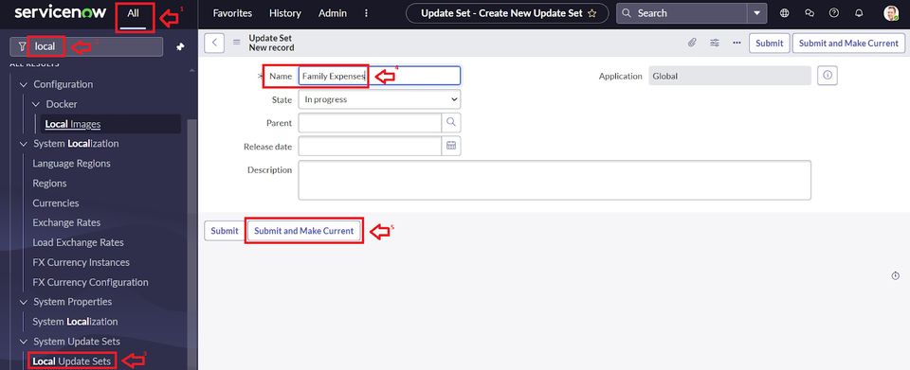
Creation of New Update Set
Go to All >> In the filter search for Local Update set > click on New.
2. Enter the Details as:
Name : Family Expenses
3. Then click on Submit and Make current.

Slide 3
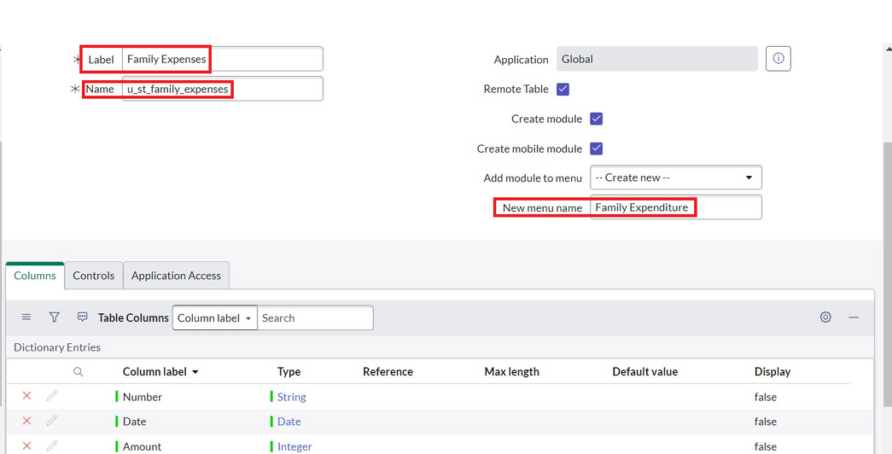
Creation of Table
Creation of Family Expenses Table
Go to All > In the filter search for Tables > click on New.
Enter the Details:
Label : Family Expenses
Name : Auto-Populated
New menu name : Family Expenditure
3. Go to the Header and right click there>> click on Save.
Creation of Columns(Fields)
Near Columns Double click near insert a new row.
Give the details as:
Column label : Number
Type : String

Slide 4
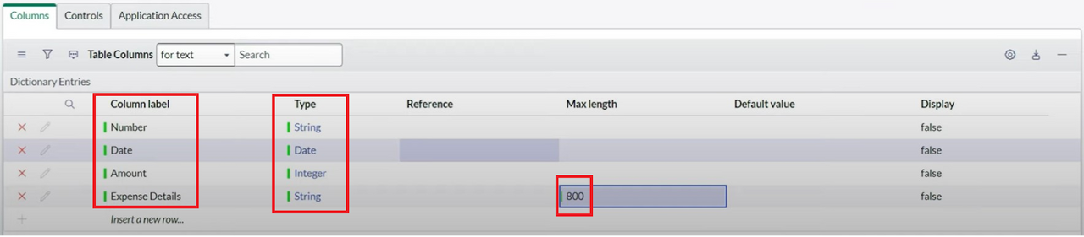
3. Double click on insert a new row again
4. Give the details as:
Column label : Date
Type : Date
5. Double click on insert a new row again
6. Give the details as:
Column label : Amount
Type : Integer
7. Double click on insert a new row again
8. Give the details as:
Column label : Expense Details
Type : String
Max length : 800
Go to the Header and right click there>> click on Save.

Slide 5
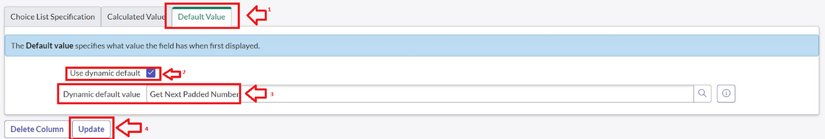
Making Number Field an Auto-Number
Double click on the Number Field/Column.
Go down and double click on Advanced view
In Default Value:
Use dynamic default : check the box
Dynamic default value : Get Next Padded Number
Click on Update.
5.Go to All >> In the filter search for Number Maintenance >> select Number Maintenance
6. Click on New.
7. Enter the below Details:
Table : Family Expenses
Prefix : MFE

Slide 6
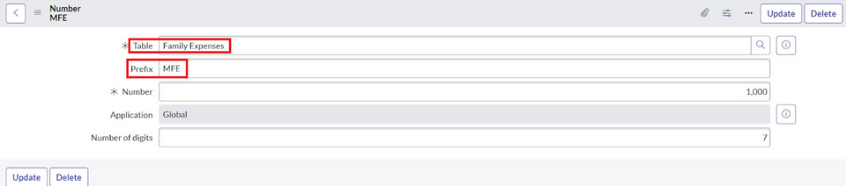
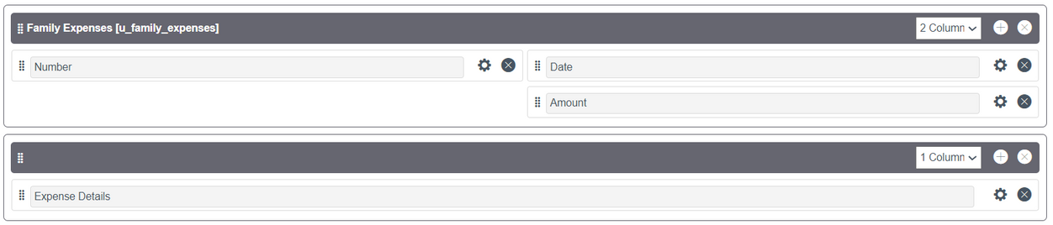
Click on Submit.
Configure the Form
Go to All >> In the filter search for Family Expenses >> Open Family Expenses
Click on New
Go to the Header and right click there>> click on Configure >> Select Form Design
Customize or Drag Drop the form as per your requirement.

Slide 7
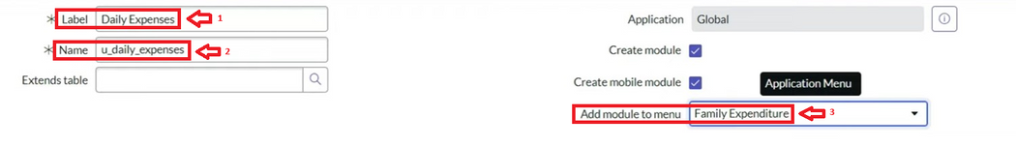
Make Number Read-Only Field by clicking on the gear icon and checking Read-Only
Make Date, Amount Mandatory Field by clicking on the gear icon and checking Mandatory
Click on Save.
Creation of Table(Daily Expenses)
Creation of Daily Expenses Table
Go to All > In the filter search for Tables > click on New.
Enter the Details:
Label : Daily Expenses
Name : Auto-Populated
Add Module to menu : Family Expenditure
Go to the Header and right click there>> click on Save.

Slide 8
Creation of Columns(Fields)
1.Near Columns Double click near insert a new row.
2.Give the details as:
Column label : Number
Type : String
3.Double click on insert a new row again
4.Give the details as:
Column label : Date
Type : Date
5.Double click on insert a new row again
6.Give the details as:
Column label : Expense
Type : Integer
7.Double click on insert a new row again
8.Give the details as:
Column label : Family Member Name
Type : Reference
Max length : 800
9.Double click on insert a new row again
10.Give the details as:
Column label : Comments
Type : String
Max length : 800
11.Go to the Header and right click there>> click on Save.

Slide 9
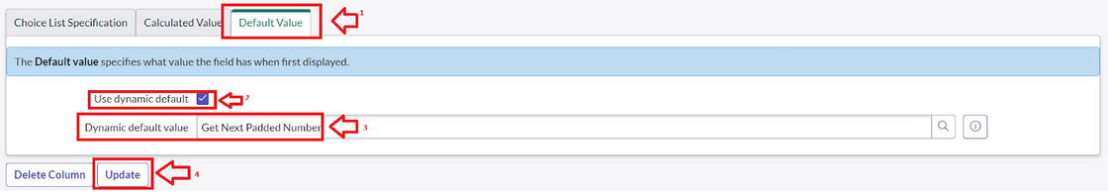
Making Number Field an Auto-Number
Double click on the Number Field/Column.
Go down and double click on Advanced view
In Default Value:
Use dynamic default : check the box
Dynamic default value : Get Next Padded Number
Click on Update.
5.Go to All >> In the filter search for Number Maintenance >> select Number Maintenance
6.Click on New.
7.Enter the below Details:
Table : Family Expenses
Prefix : MFE

Slide 10
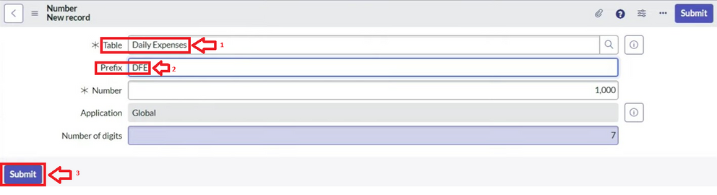
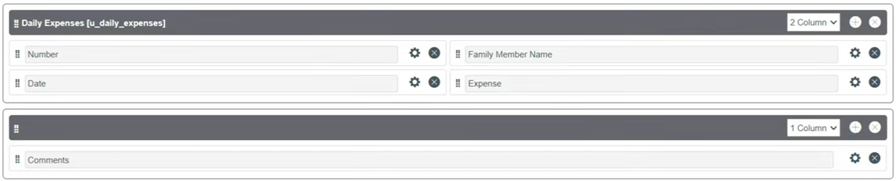
8.Click on Submit.
Configure the Form
Go to All >> In the filter search for Daily Expenses >> Open Daily Expenses
Click on New
Go to the Header and right click there>> click on Configure >> Select Form Design
Customize or Drag Drop the form as per your requirement.

Slide 11
Make Number Read-Only Field by clicking on the gear icon and checking Read-Only
Make Date, Family Member Name Mandatory Field by clicking on the gear icon and checking Mandatory
Click on Save.
Creation of Relationship
Creation of Relationship between Family Expenses and Daily Expenses tables
Go to All >> In the filter search for Relationships >> Open Relationships
Click on New.
Enter the details:
Name : Daily Expenses
Applies to table : Select Family Expenses
Daily Expenses : Select Daily Expenses
Click Save.

Slide 12
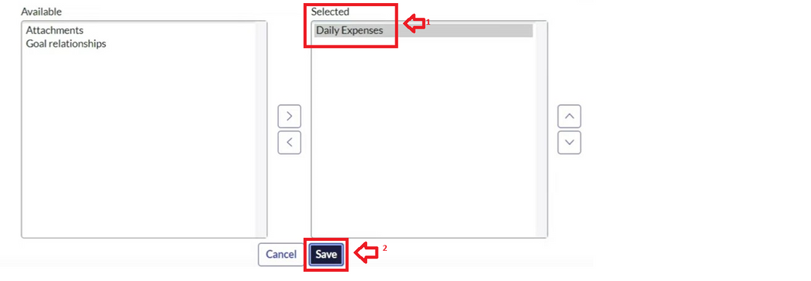
Configuring Related List on Family Expenses
Configuring Related List on Family Expenses
Go to All >> In the filter search for Family Expenses >> Open Family Expenses
Click on New
Go to the Header and right click there>> click on Configure >> Select Related Lists
Add Daily Expenses to the Selected Area.
Click on Save

Slide 13
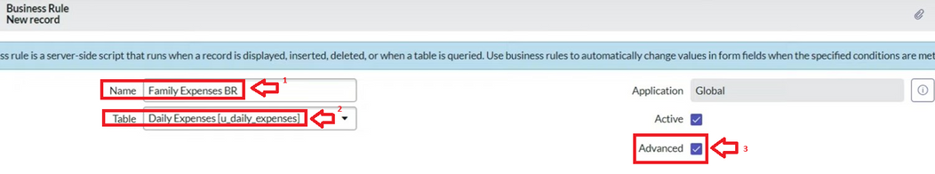
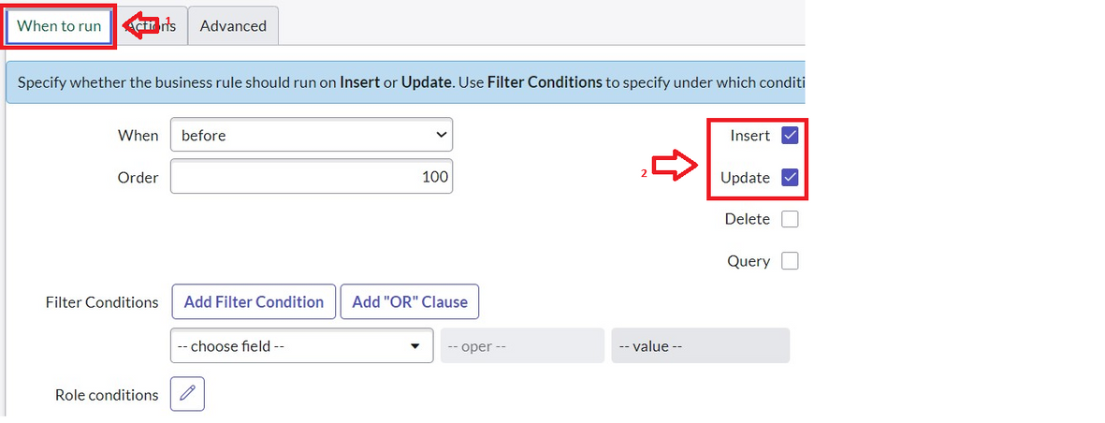
Creation of Business Rules
Go to All >> In the filter search for Business Rules.
Under System Definition Select Business Rules then click on New.
Enter the Details:
Name : Family Expenses BR
Table : Select Daily Expenses
Check Advanced
In when to run Check Insert and Update

Slide 14
In Advance(we write the code): Write the below code >>
(function executeRule(current, previous /*null when async*/) {
var FamilyExpenses = new GlideRecord('u_family_expenses');
FamilyExpenses.addQuery('u_date',current.u_date);
FamilyExpenses.query();
if(FamilyExpenses.next())
{
FamilyExpenses.u_amount += current.u_expense;
FamilyExpenses.u_expense_details += ">"+current.u_comments+":"+"Rs."+current.u_expense+"/-";
FamilyExpenses.update();
}
else
{
var NewFamilyExpenses = new GlideRecord('u_family_expenses');
NewFamilyExpenses.u_date = current.u_date;
NewFamilyExpenses.u_amount = current.u_expense;
NewFamilyExpenses.u_expense_details += ">"+current.u_comments+":"+"Rs."+current.u_expense+"/-";
NewFamilyExpenses.insert();
}
})(current, previous);

Slide 15
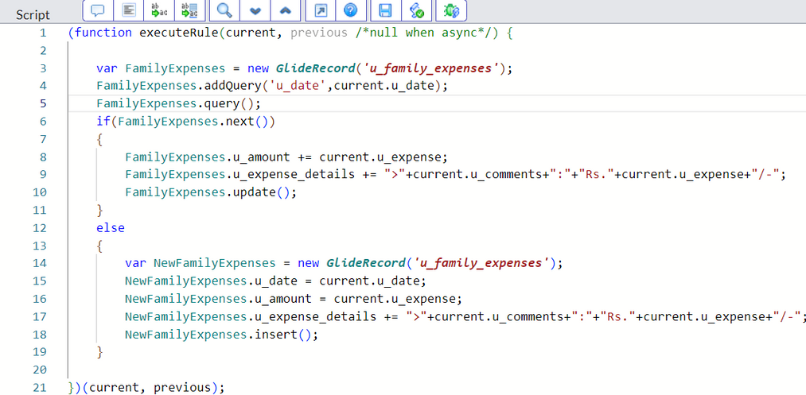
6.Go to the Header and right click there>> click on Save.

Slide 16
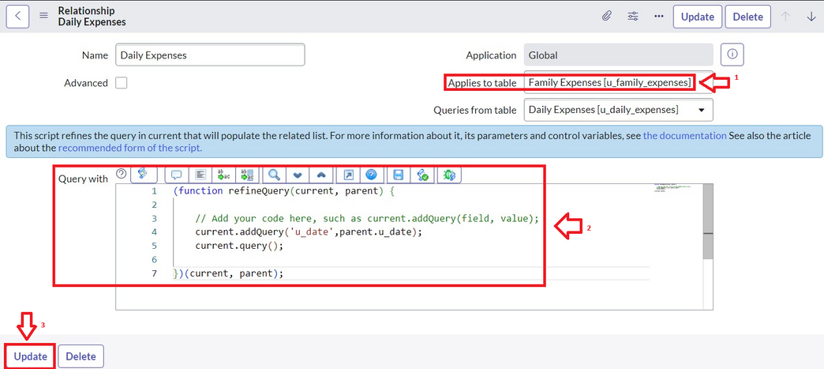
Configure the Relationship
1.Go to All >> In the filter search for Relationships >> Open Relationships.
2.In that, open Daily Expenses Relationship.
3.For Applies to table : Select Family Expenses.
4.In Query with : write the below Query.
(function refineQuery(current, parent) {
// Add your code here, such as current.addQuery(field, value);
current.addQuery('u_date',parent.u_date);
current.query();
})(current, parent);
5.Click on Update.

Slide 17
Conclusion:

